Slide 1
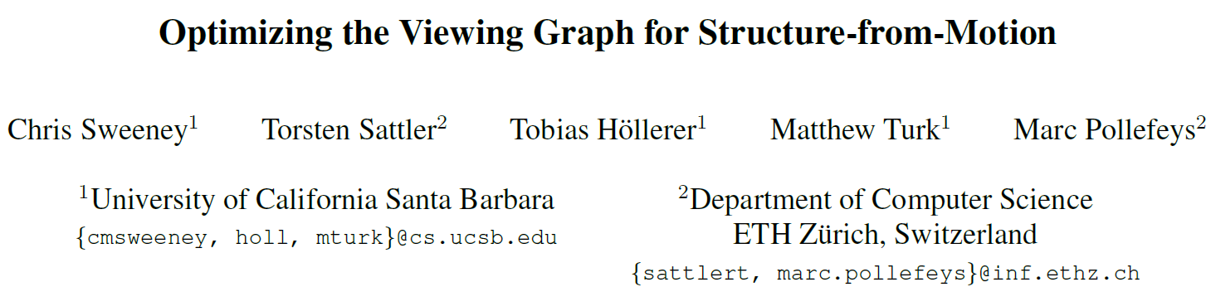
International Conference on Computer Vision (ICCV),2011.
Reporter: Ge Linlin
Date: 2019.05.27

Slide 2
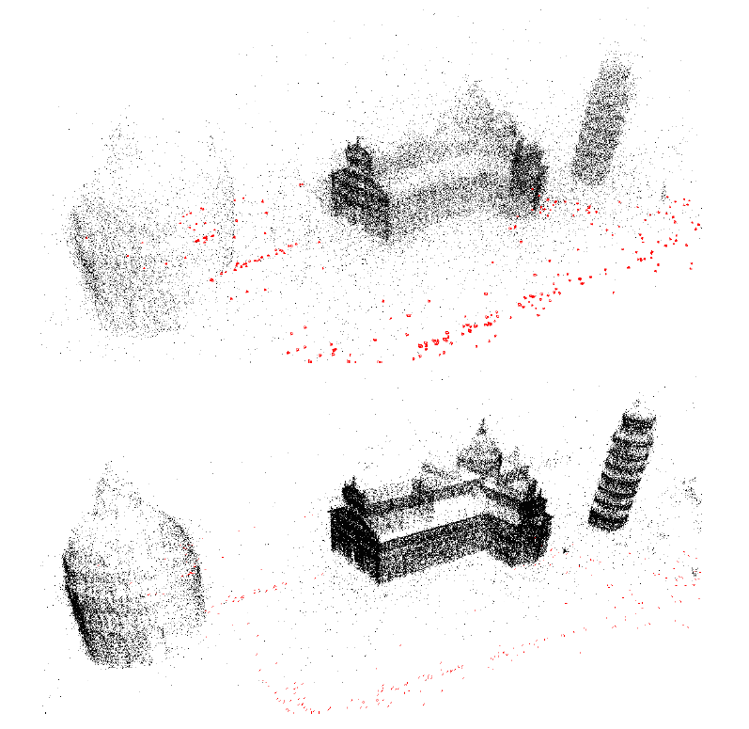
1. Introduction
A novel optimization that improves the quality of the relative geometries by enforcing loop consistency constraints with the epipolar point transfer.

Slide 3
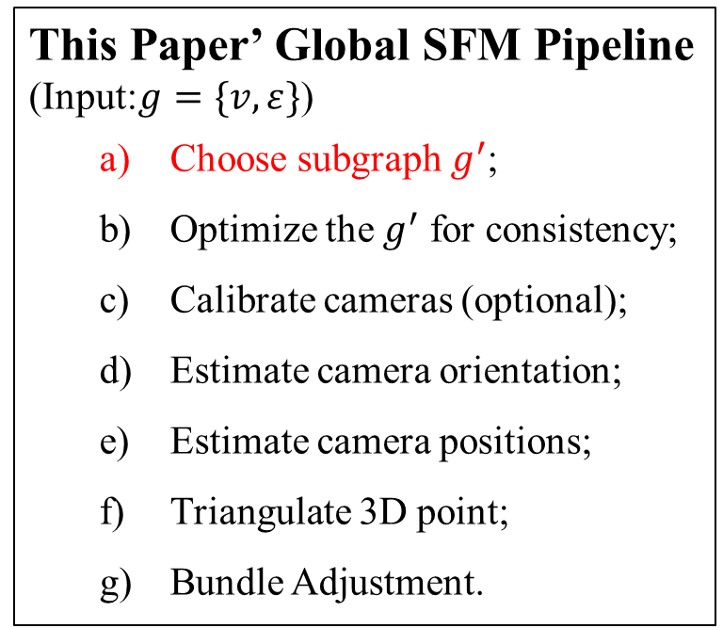
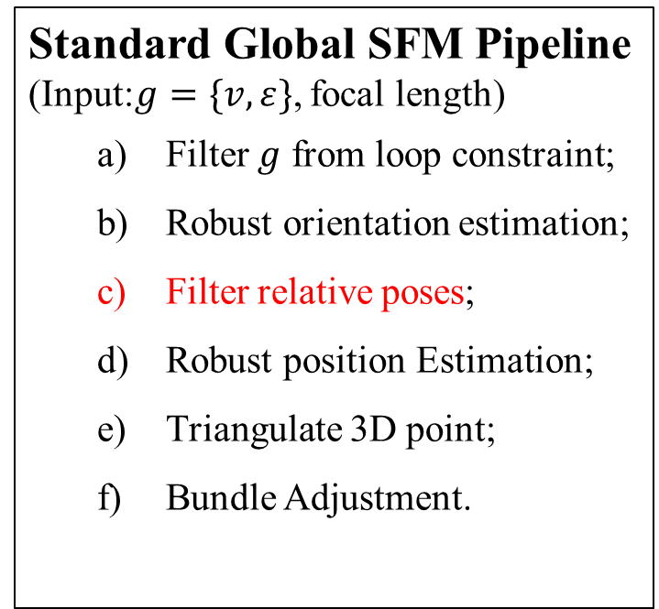
1. Introduction
Standard Global SFM Pipeline
(Input:$g=\{v,ε\}$, focal length)
Filter $g$ from loop constraint;
Robust orientation estimation;
Filter relative poses;
Robust position Estimation;
Triangulate 3D point;
Bundle Adjustment.
This Paper’ Global SFM Pipeline
(Input:$g=\{v,ε\}$)
Choose subgraph $g^{′}$;
Optimize the $g^{′}$ for consistency;
Calibrate cameras (optional);
Estimate camera orientation;
Estimate camera positions;
Triangulate 3D point;
Bundle Adjustment.

Slide 4
1. Introduction
Contributions:
It is the first global SFM pipeline capable of handling uncalibrated image sets;
It provide a new method for calibrating cameras from a set of fundamental matrices.
The pipeline proposed in this paper achieves greater efficiency and comparable accuracy to the other methods.

Slide 5
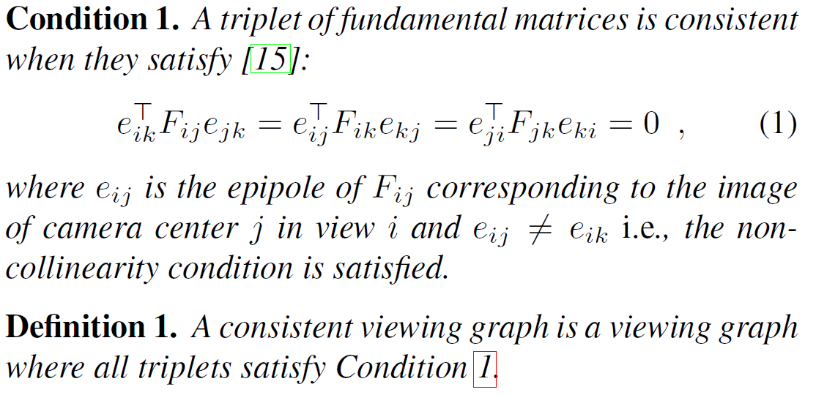
2. Definition

Slide 6
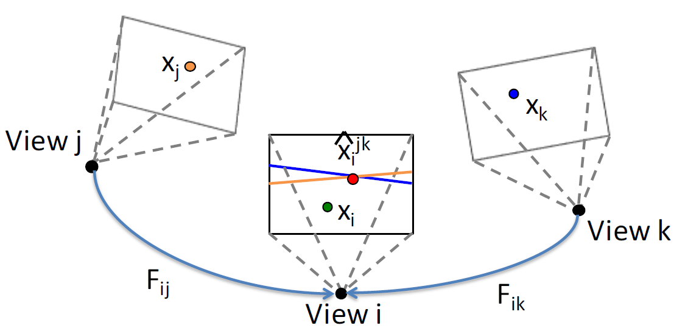
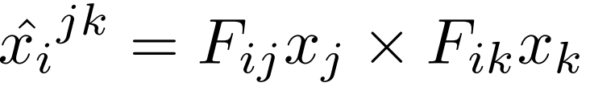
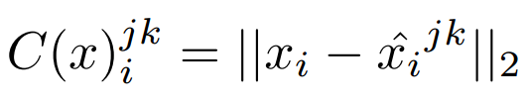
3. Create a Consistent Viewing Graph
Loop Consistency
Epipolar point Transfer:
Cost Function:

Slide 7

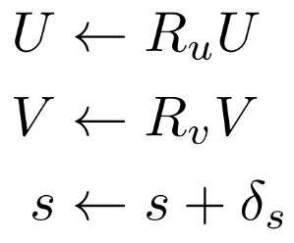
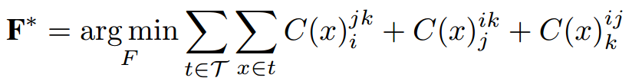

3. Create a Consistent Viewing Graph
Adjust Fundamental Matrices
SVD for fundamental matrix:
Define adjustment parameters:
Nonlinear Optimization
Define new objective function by considering loop consistency constraint:
$x$ is a feature track
Effect:
Greatly improved the rate of convergence.

Slide 8
3. Create a Consistent Viewing Graph
Nonlinear Optimization

Slide 9
3. Create a Consistent Viewing Graph
Nonlinear Optimization
Condition 1
The transfer point lies on the trifocal plane of the image i, j and k.
Solution
Do not consider points where the two transfer lines are nearly parallel or the transfer lines lay near the epipole.
The latter scenario can be checked by examining the norm of the transfer line.
Condition 2
The tree camera centers are collinear.
Solution
Remove collinear triplets where the epipoles are equal.

Slide 10
4.1 Viewing Graph Optimization
Target
Find a minimal set of edges that provide sufficient coverage over all views in the viewing graph.

Slide 11
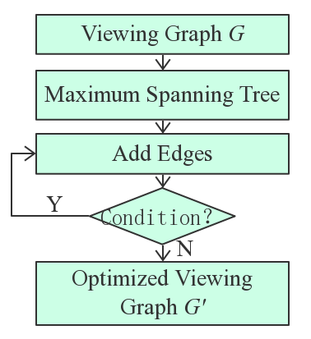
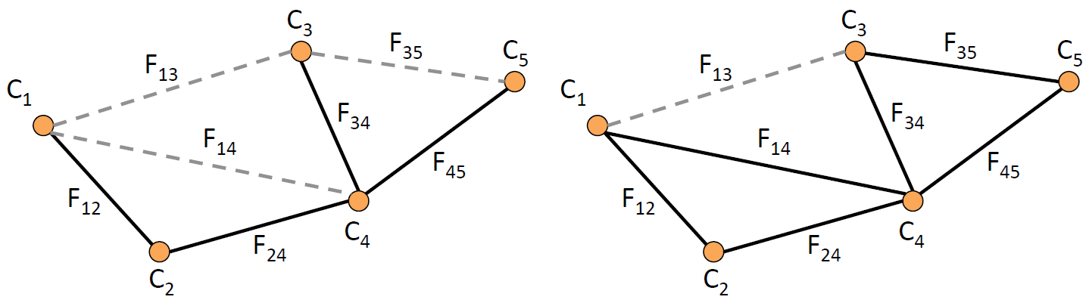
4.1 Viewing Graph Optimization
Edge Optimization
Condition
Every view is in at least one triplet.
There are no more “good” edges that can be added.

Slide 12
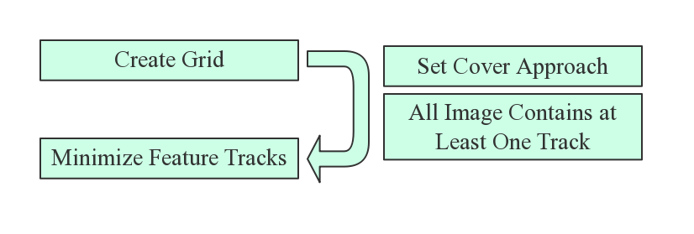
4.1 Viewing Graph Optimization
Features Optimization

Slide 13
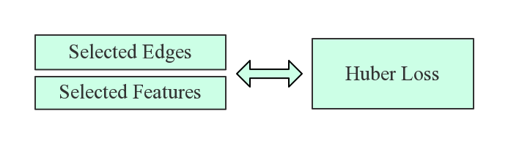
4.2 Viewing Graph Optimization
Optimization Structure

Slide 14
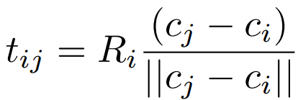
4.2 Estimating Motion
Assume cameras have been calibrated
Solve orientation
Cost function: relative rotation constraint
Use the angle-axis parameterization to solve for matrices
Initialization: chaining relative rotation from a random spanning tree
enforcing the relative rotation constraint

Slide 15
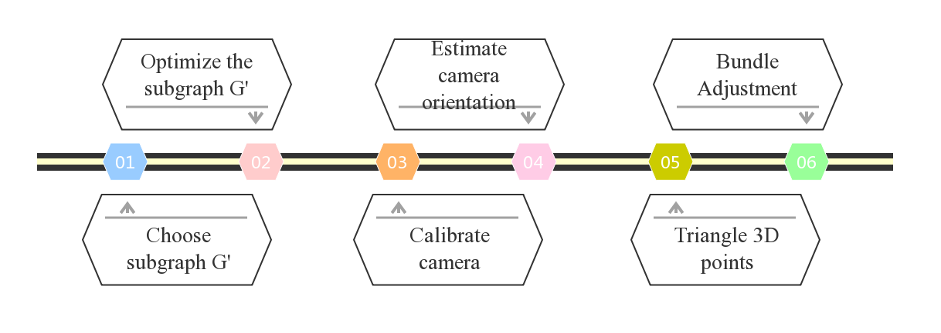
4.3 Pipeline

Slide 16
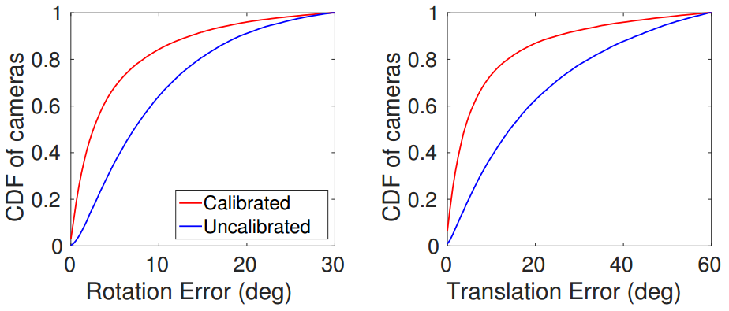
4.3 Calibrated Vs. Uncalibrated

Slide 17
5 Focal Length Calibration

Slide 18
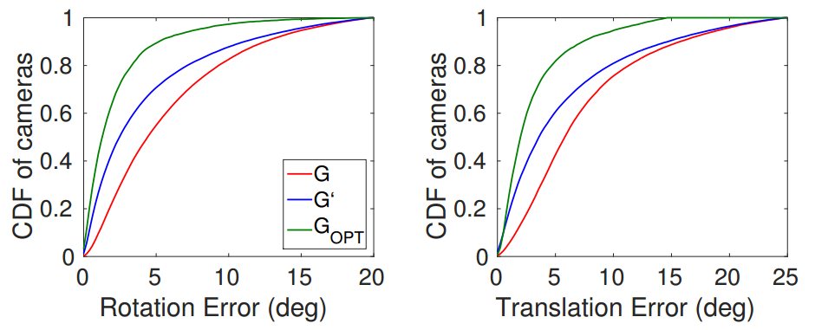
6 Test for Viewing Graph Optimization

Slide 19
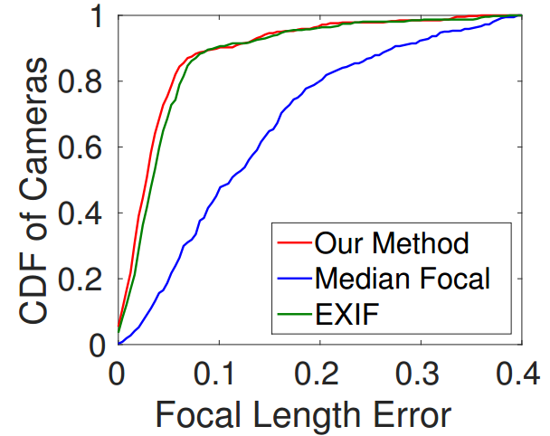
6 Results——Test for Focal Length Calibration

Slide 20
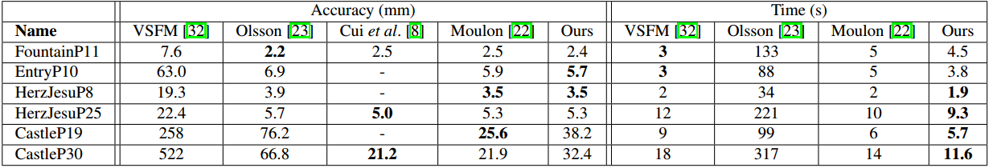
6 Results—— Test for Proposed Pipeline

Slide 21
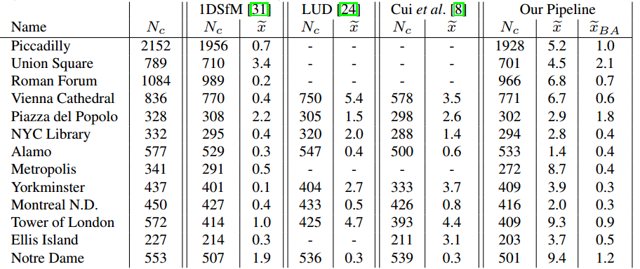
6 Results

Slide 22
5. Conclusion
wo

Slide 23
Q1: What is SO(3) rotation and O(3) matrices?
Q2: Why the epipole is in the null space of fundamental matrix？
Q3: What is the norm of transfer line?
Q4: How to get fundamental matrix?

Slide 24
Thanks!

